Slide 1
Senior Project Presentation
Samuel Wade

Slide 2
Why make this project?
Say you want to meet your friend at a restaurant. To send the link to the directions you would have to open a web browser, find the location, copy the link, and send it to your friend. Or alternatively open your map application and have to find the share link button which is usually not super easy to find.
With this application you simply choose which contact you want to send the location to and then choose the location.

Slide 3
Research
To research this project, I did a lot of reading up on building applications using Android studio, and Java based programming.
I also looked into how to implement the Google Maps API to be able to implement a map.

Slide 4
Languages, software, and hardware
Languages:
Java
Software:
Android Studio
Android Virtual Device
Hardware:
A friend’s Google Pixel 4

Slide 5
requirements
To be able to have a running application that satisfies the purpose of the project.

Slide 6
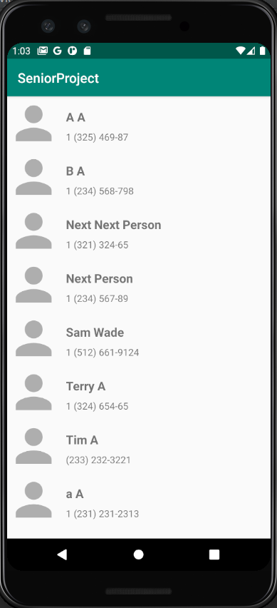
Implementation & Explanation
The first step in the flow of the application is shown in Fig 1. this figure shows a list of the users list of contacts.
To implement this, I used the built in API that Android Studio has that allowed me to have a loop to populate the contacts list.
Fig 1. Home Screen

Slide 7
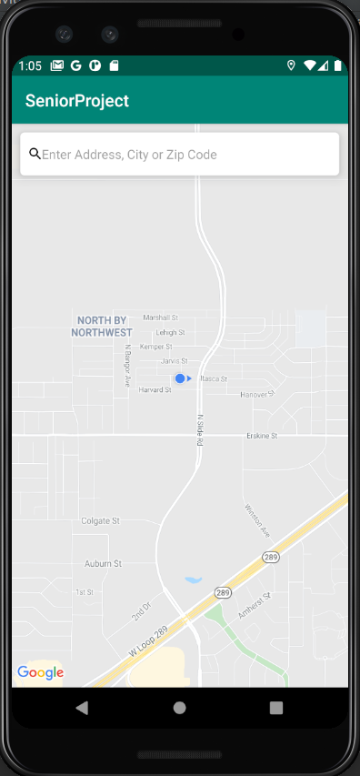
Implementation & explanation cont.
The next step in the flow of the application is shown in Fig 2. this figure shows the map that is presented to the user after they have chosen their desired contact.
To implement this, I used the Google Maps API that is custom to Android Studio. The API allows me to present the user with a map with the user's current location and a search bar.
Fig 2. Map

Slide 8
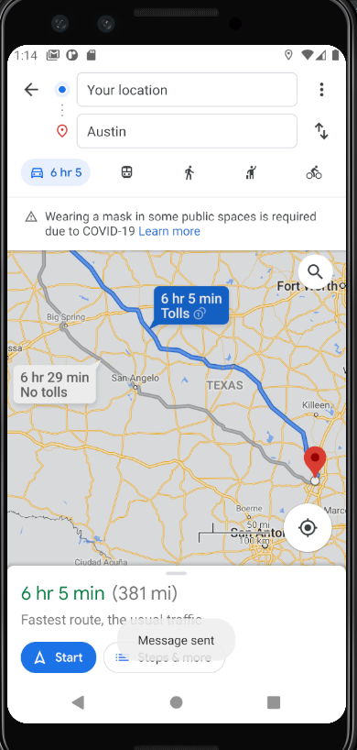
Implementation & explanation cont.
The next step in the flow of the application is shown in Fig 3. this figure shows the Google Maps directions to the location that the user has chosen. With a success message telling the user that the text message was sent to the desired contact.
Using the same Google Maps API, I used the location the user choose and put that into a link that opens with the directions to get to the chosen location.
Also, to implement this I used another built in Android API that allows me to choose a message to send to a phone number, so using this I send the chosen contact the same link that the user’s screen is populated with.
Fig 3. Success Map

Slide 9
Test plan + results
To test the project, I had a lot of different console outputs that would tell me the chosen contact, current location of the user, the location that the user has chosen, and whether the correct message was being sent to the contact. There was not a lot of options for me in the way of unit testing, so I feel like this was the best route to test and debug the program.

Slide 10
Challenges Overcame
Learning Android Studio
Google Maps API
AVD (Android Virtual Devices)

Slide 11
Future enhancements
Better search bar
More intuitive map
Select multiple contacts from contact list
Better looking UI

